Slide 1
Capstone Project
The Battle of Neighborhoods - Presentation
Applied Data Science Capstone by IBM / Coursera
Stephenas Ali
2019

Slide 2
Introduction: Business Problem
Target Audience:
Stakeholders interested in opening an coffee shop near to Downtown Miami, in Florida.
Objectives:
To detect the most suitable location, in or around the surrounding neighborhoods
Select areas with no existing coffee shops
Select areas with popular venues or businesses to attract potential customers

Slide 3
Data
Information will be gathered from the following data sources:
A Wikipedia entry with a list of neighborhoods in Miami.
Foursquare API - To identify existing coffee shops and other venues of interest.

Slide 4
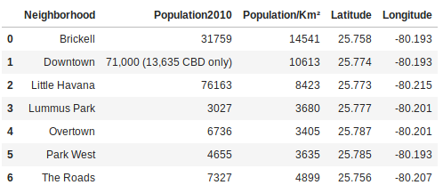
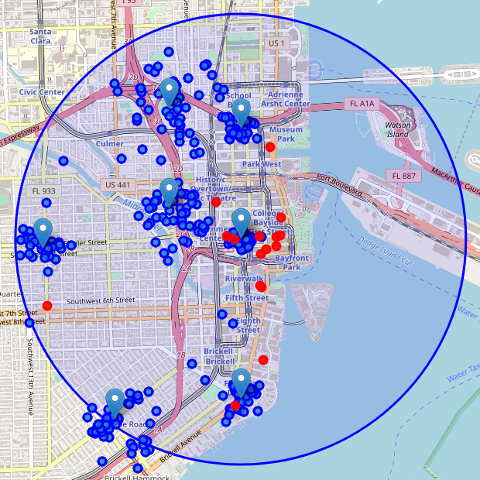
Summary of Data
Total number of places of interests: 350
Total number of coffee shops: 16
Percentage of coffee shops to general places of interests: 4.5
Average number of coffee shops per neighborhood: 2.286

Slide 5
Methodology
Select the neighborhoods closest to Downtown Miami
Categorize each neighborhood relative to the average number of Coffee Shops
Select neighborhood with the lowest number of Coffee Shops
Recommend the best location to setup a new Coffee Shop in the selected neighborhood

Slide 6
Select the Neighborhood
The haversine formula was used to calculate and select the most suitable neighborhoods closest to Downtown Miami

Slide 7
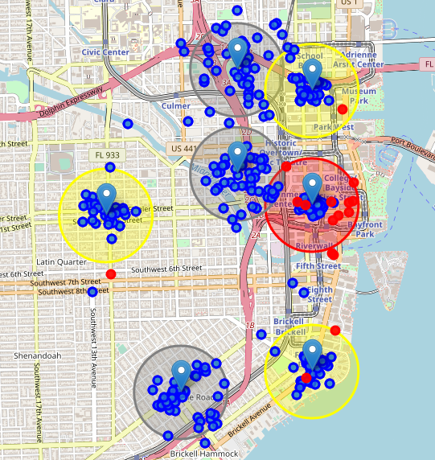
2. Neighborhood Categorization
Each neighborhood were categorized according to the average number of coffee shops. The categories included:
Red - Above average
Yellow - Below average
Gray - No Coffee Shops

Slide 8
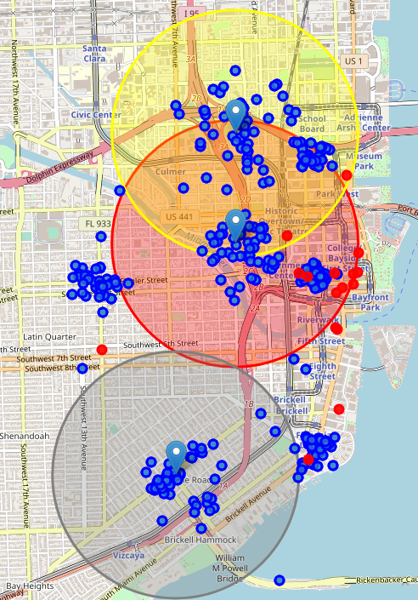
2. Neighborhood Categorization
The neighborhoods with no coffee shops were selected and the procedure was repeated.
The radial distance was increased from 500 meters to 1.25km to find coffee shops in a wider range.
And the data was then re-categorized.

Slide 9
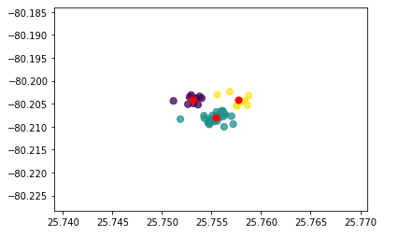
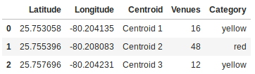
3. Neighborhood with Lowest No. of Coffee Shops
Eventually neighborhood The Roads was selected
K-means clustering was then used to find the largest cluster of venues of interest.
A cluster of 3 was applied on the venues dataset and a simple scatter plot was created.

Slide 10
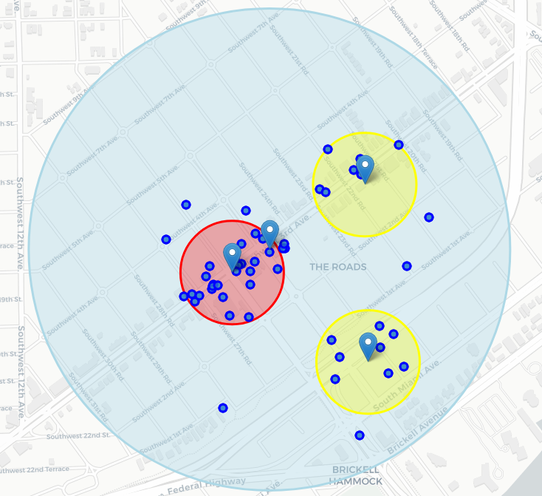
4. Recommend Best Location
The centroids created by the k-means algorithm were then categorized and plotted onto the map.
Using the map we can tell that the best location to open a new coffee shop may be in the neighborhood of The Roads, at the intersection of SW 3rd Avenue and SW 26th Road.

Slide 11
Conclusion
Purpose of this project was to aid stakeholders in narrowing down the search for optimal location for a new coffee shop in the vicinity of Downtown Miami. To accomplish this we:
Identified prospective neighborhoods, and then identified existing coffee shop distributions and supporting businesses using Foursquare data.
Applied various predictive models to determine the most viable option for a new coffee shop.
Then recommended solution satisfying low competition, supportive business establishments and whilst also being close to Downtown Miami.

